Slide 1
Beyond familiar scripts: Assessing Trade marks outside Latin and Cyrillic scripts
Judge Krystyna Kowalik-Bańczyk
Emerging Frontiers of EU Trade Mark Adjudication
21 May 2026

Slide 2
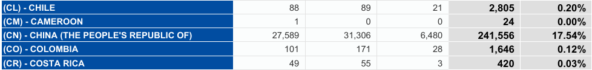
EUTM Applications From China 1996-2026
*EUIPO Statistics for European Union Trade Marks
1996-01 to 2026-03 Evolution

Slide 3
  When does "foreign" script matter?
1. Distinctiveness
Perception of relevant public
2. Likehood of confusion
How the script is used
3. Bad faith
4. Genuine use

Slide 4



C-147/14, Loutfi v AMJ Meatproducts
Assessing likelihood of confusion between two marks :
pronunciation and meaning of non-latin script must be taken into account
If relevant public would consider those factors

Slide 5

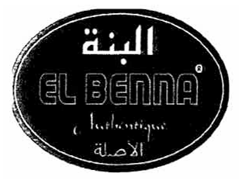

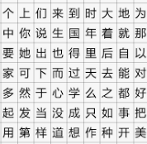
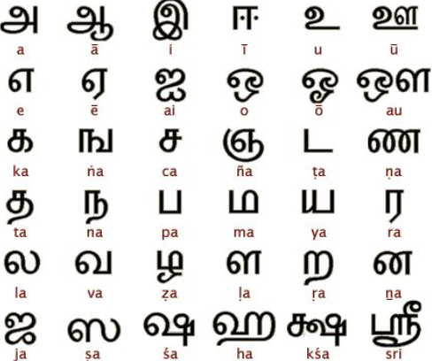
Why does foreign script matter?
Case Loufti – Arabic script
Also foreign characters :
TM applications with foreign script – distinctive character may be weaker/stronger if relevant public for mark is made up of speakers of this language
Chinese Thamil

Slide 6
What if foreign script is transliterated?
Non-European words transliterated into Latin characters
(where relevant public understands it)
Pinyin : official romanization system of transliteration of Chinese characters
Examples :
T-140/24, Baidu : "hundred times" or "hundred degrees" representing persistent search for the ideal
T-533/23 Hongqi : "Red Flag" - iconic Chinese luxury car brand, established in 1958

Slide 7
Determination of relevant public stems from factual assessment
So far no decision finding that a sufficiently large part of the relevant public formed of Chinese speakers
Same for Laotian or Thai languages – T-286/02 Oriental Kitchen SARL/OHIM, para 41
If list of goods or services is not restricted to items that can be considered as specifically targeted at certain group of consumers – like halal food for Muslim public – the broader general public shall be taken into consideration

Slide 8
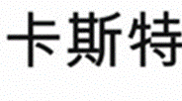
T‑323/21, Castel Frères / EUIPO - Shanghai Panati (representation of Chinese Character)
BoA: differences between contested mark and mark as used were such as to alter distinctive character of contested mark

Slide 9
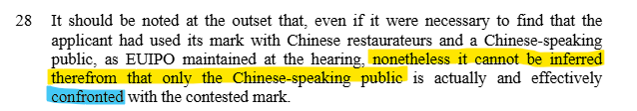
T‑323/21, Castel Frères / EUIPO - Shanghai Panati (representation of Chinese Character)
mere fact that Chinese characters forming contested mark may be identified by Chinese-speaking public is not in itself sufficient to establish and define particular category of consumers targeted by contested mark
proportion of public which spoke and understood Chinese in relation to total population of France could not be regarded as a substantial proportion of average French consumers

Slide 10
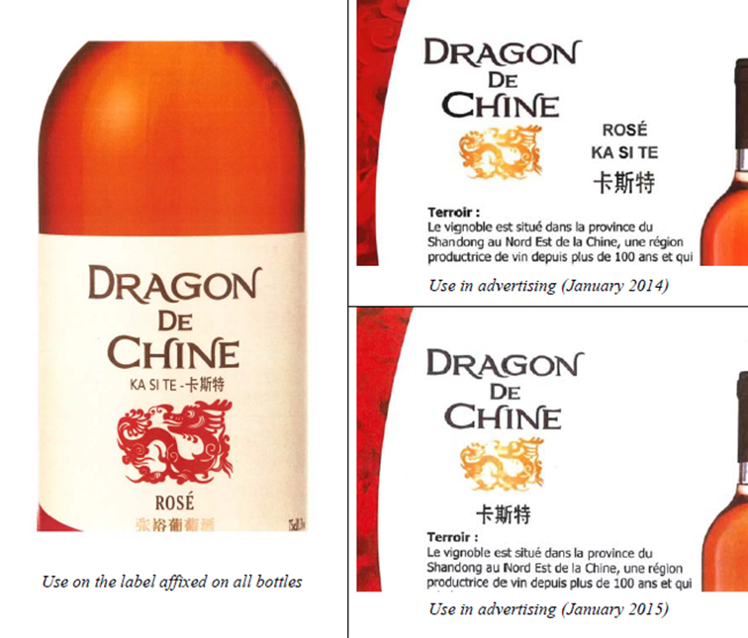
Nature of use
TM in registered form - figurative mark consisting of three characters
Distinctive and dominant word elements ‘dragon de chine’ and representation of dragon added to Chinese characters alter distinctive character

Slide 11
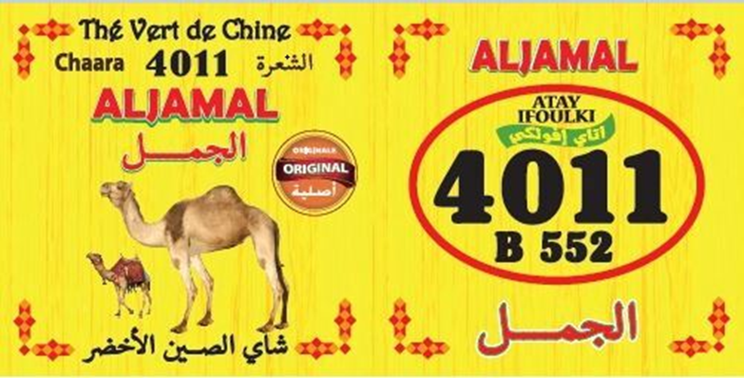
Decorative elements only - T‑95/24, Laura Food Srl
Arabic word elements and figurative elements of mark
→ will be perceived as mere decorative elements

Slide 12



Bad Faith - T-128/24,
Guangzhou Wanglaoji Grand Health v EUIPO – Multi Access
(Representation of three Chinese characters)
  true owner claim
repetitive conduct

Slide 13
Comments
Foreign signs - mere decorative elements?
Their semantic content might matter – if descriptive, not distinctive or likelihood of confusion
bad faith as a ground for invalidity – needs to be proven (not so obvious)
Chinese community is not considered to be a substantial part of the EU relevant public (YET?)

Slide 14
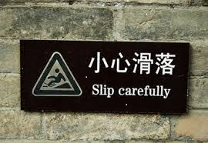
Thank you for your attention

